Slide 1
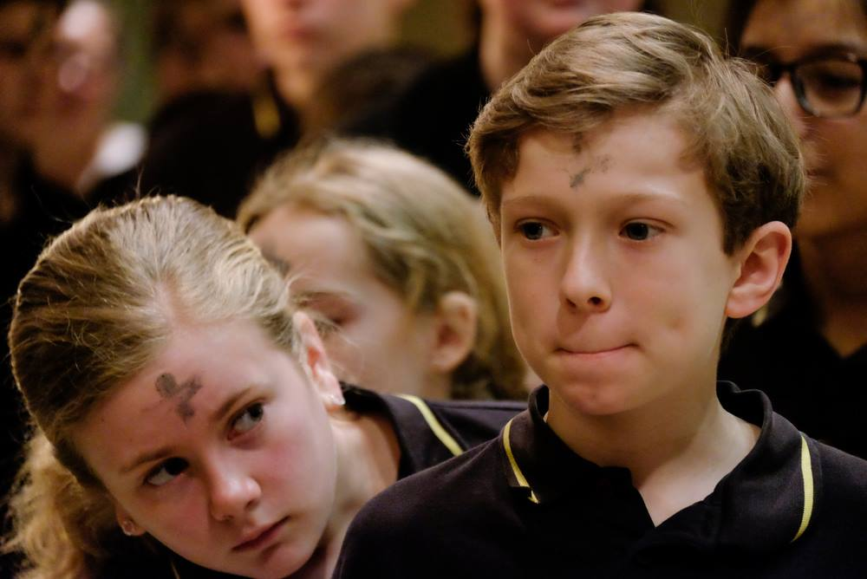

Slide 2
L-ERBGĦA
TAL-IRMIED

Slide 3
Ir-Randan żmien favorevoli

Slide 4
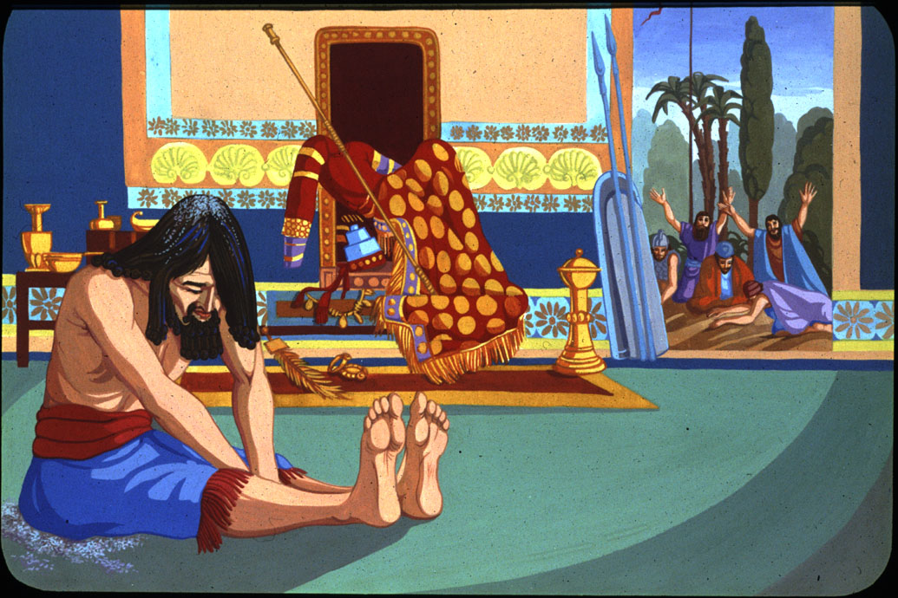
“… u qagħad fuq l-irmied.”

Slide 5
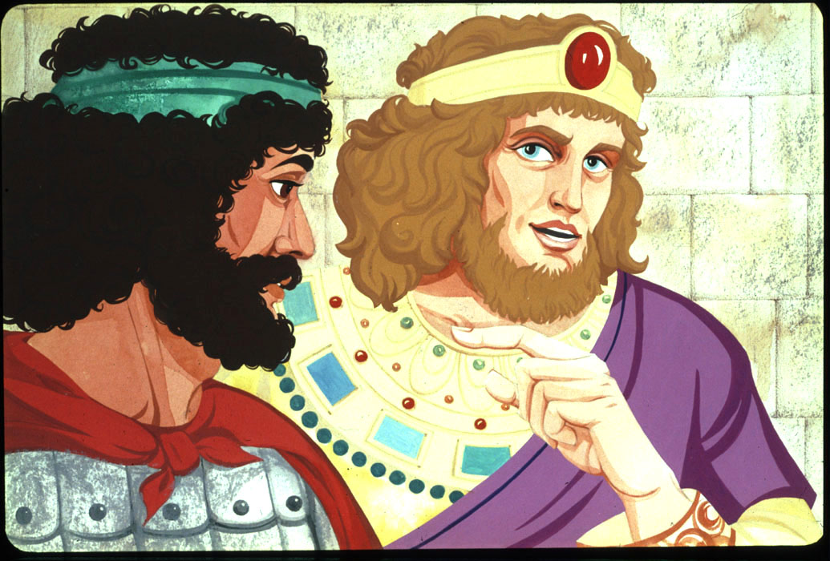
“U sam David u għadda l-lejl mixħut fl-art.”

Slide 6
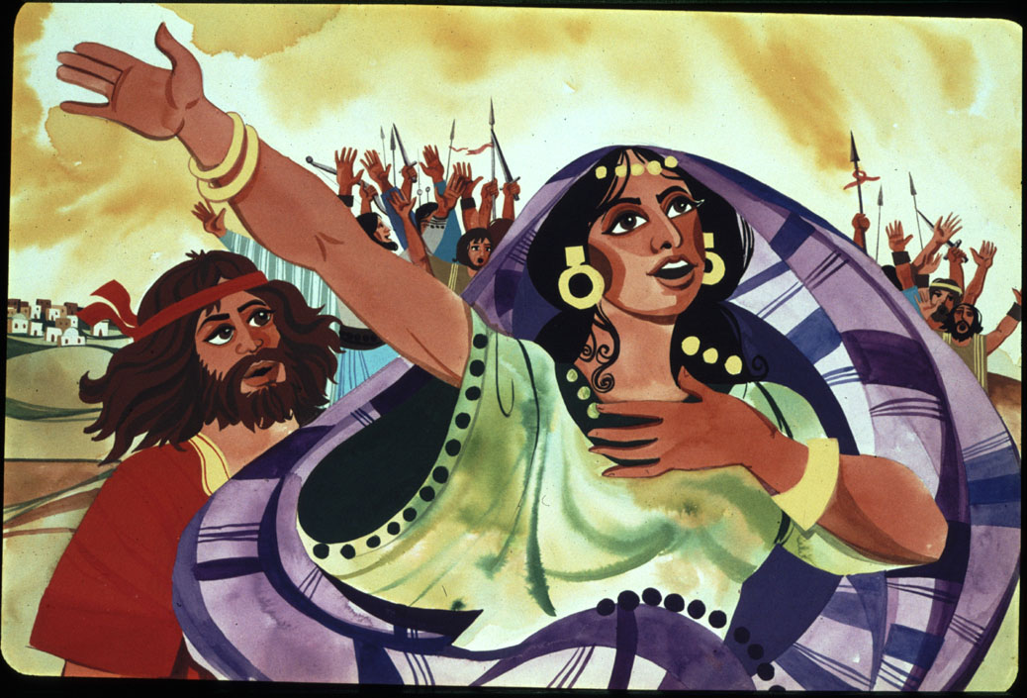
“Kieku ilhom li nidmu
bl-ixkora u bl-irmied.”

Slide 7
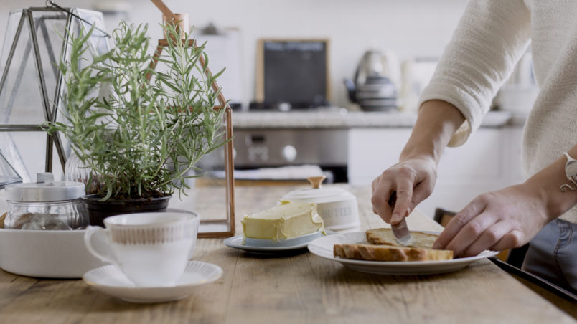
Sawm u astinenza

Slide 8
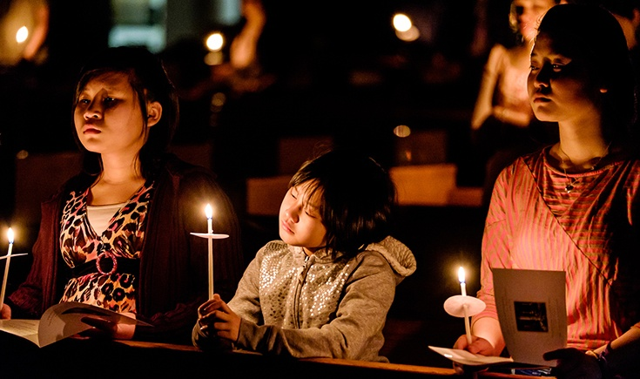
Nagħmlu karità,
nitolbu u nsumu.

Slide 9
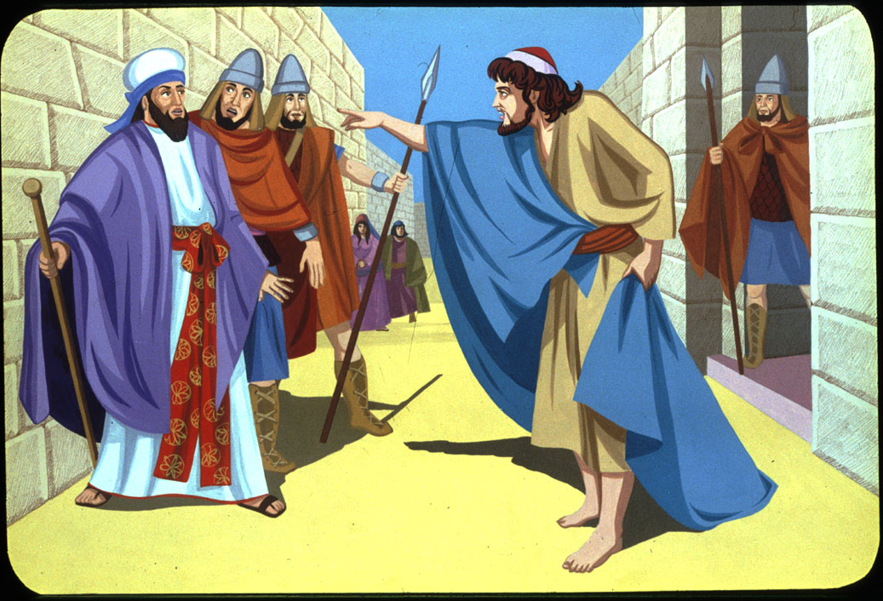
“Ċarrtu qlubkom, mhux ilbieskom.”

Slide 10
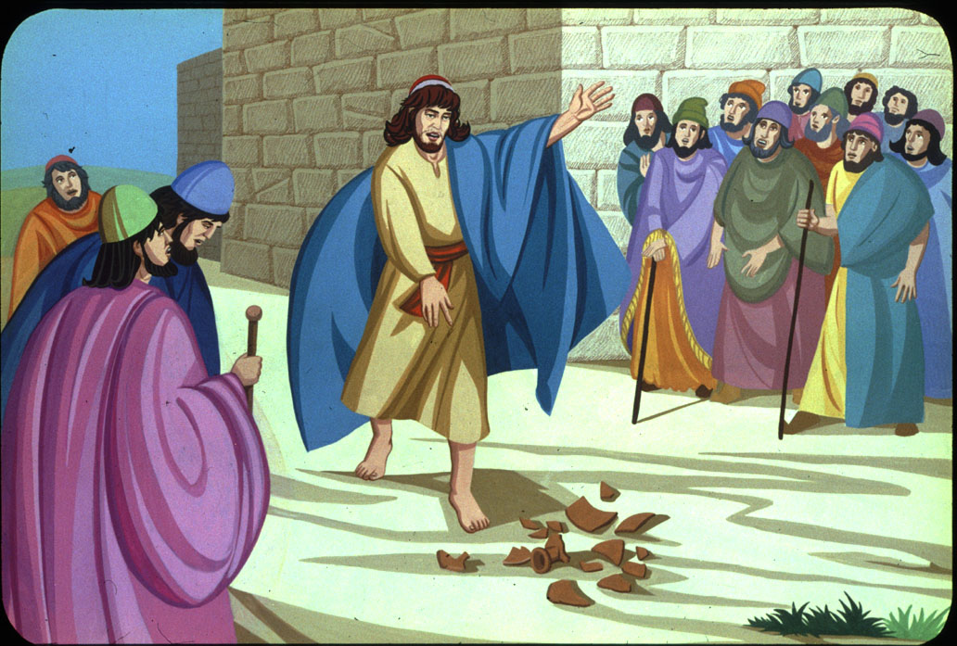
“Ordnaw sawma!”

Slide 11
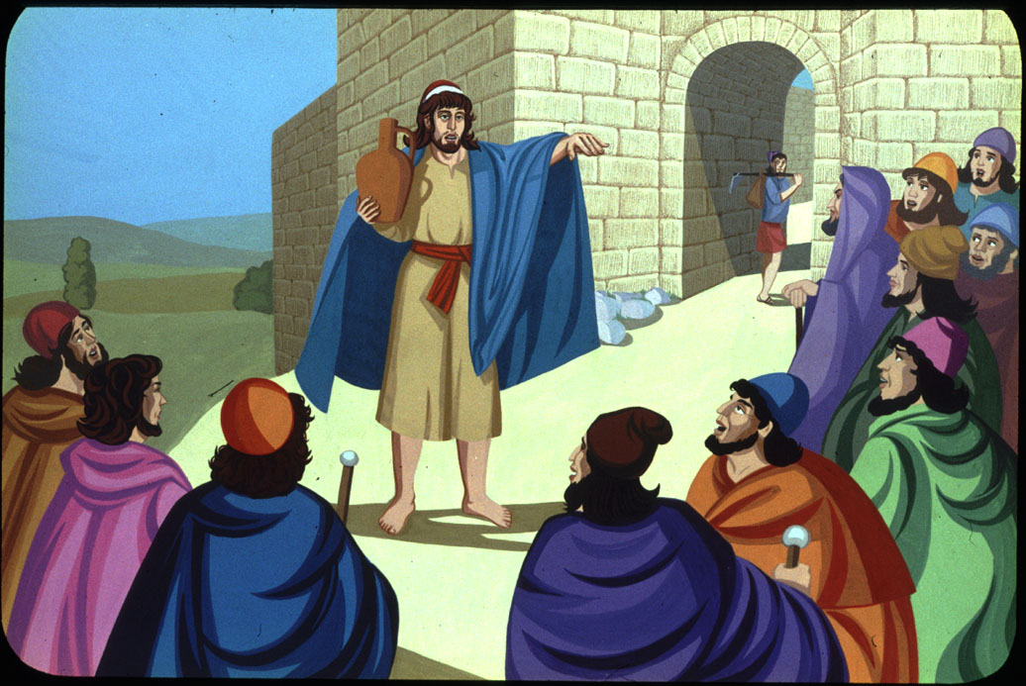
should be consumed between meals
“Ħenn għall-poplu tiegħek, Mulej!”

Slide 12
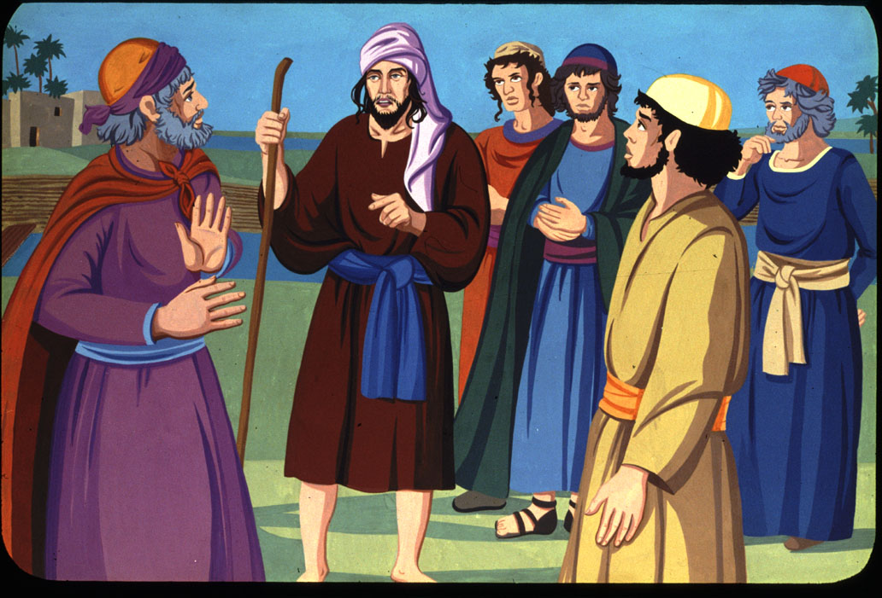
“O Alla, ħenn għalina għax dnibna.”

Slide 13
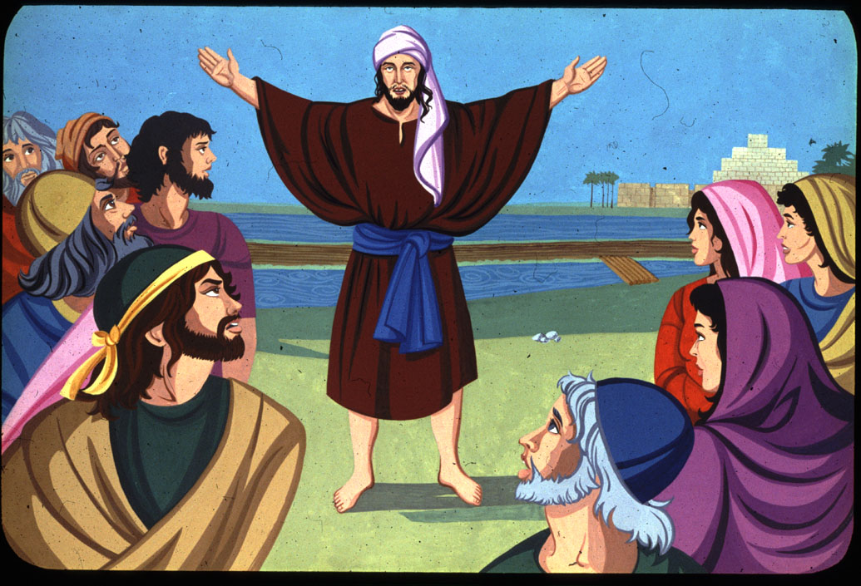
should be consumed between meals
“Kontrik biss jiena dnibt.”

Slide 14
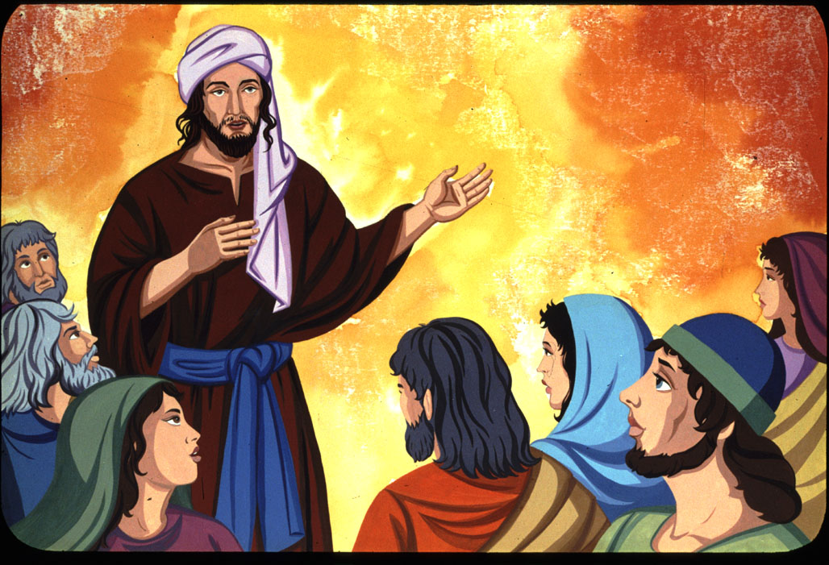
should be consumed between meals
“La twarrabnix minn quddiemek.”

Slide 15
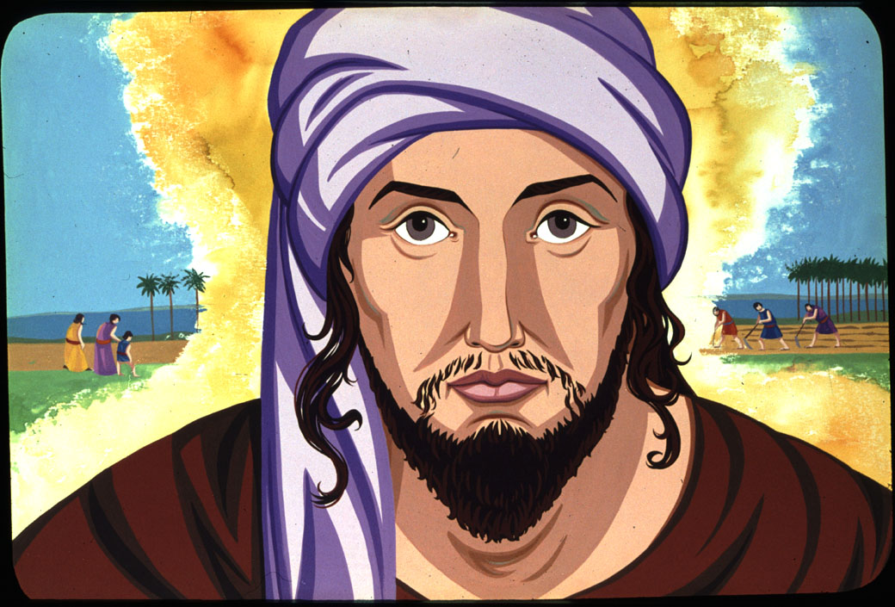
should be consumed between meals
“Roddli l-hena tas-salvazzjoni.”

Slide 16
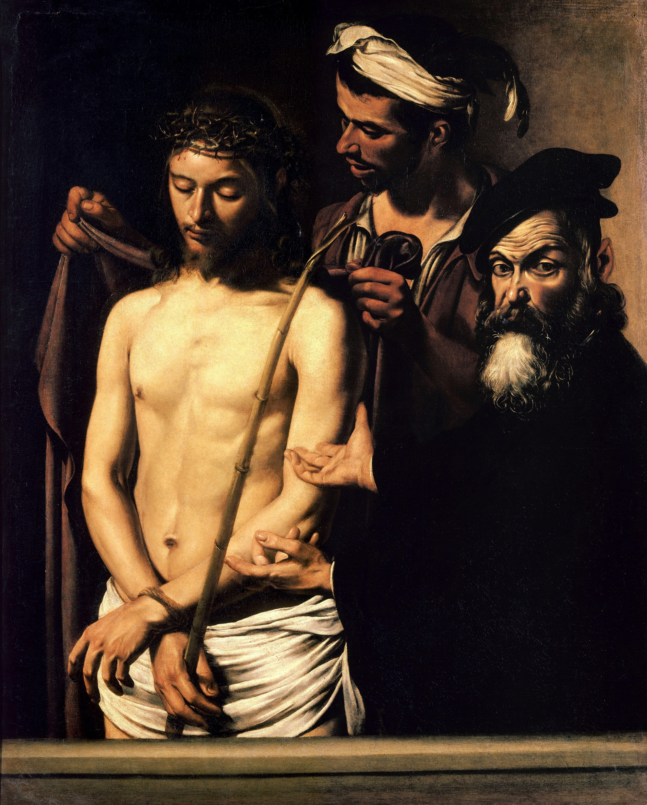
“Dak li ma kienx jaf x’inhu dnub.”

Slide 17
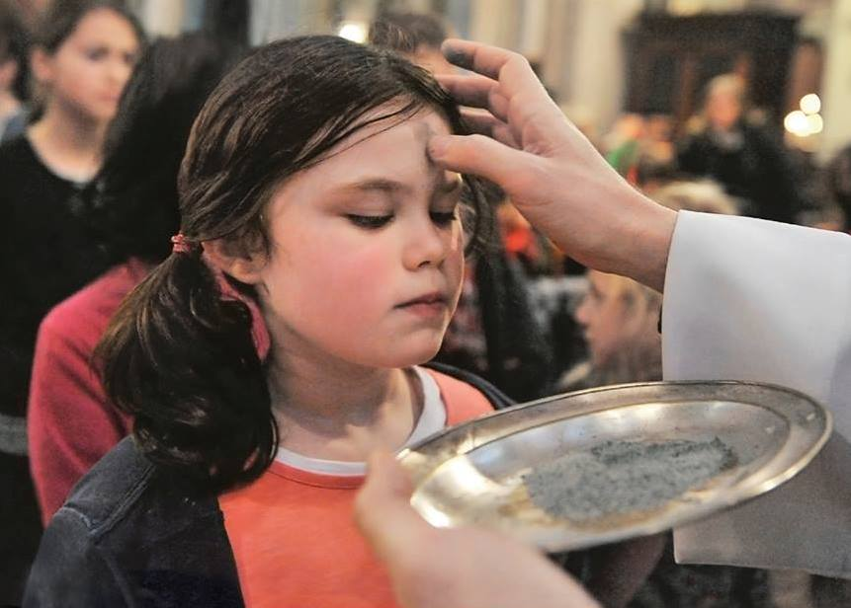
“Issa hu żmien tajjeb.”

Slide 18
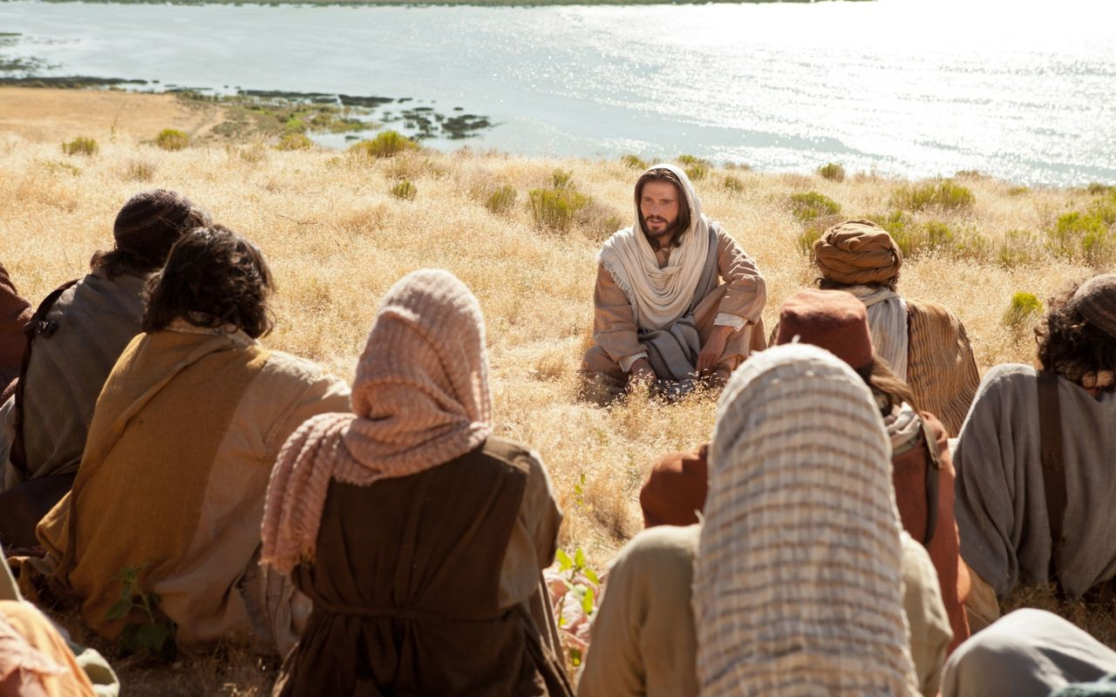
“Ma jkollkomx ħlas
minn missierkom.”

Slide 19
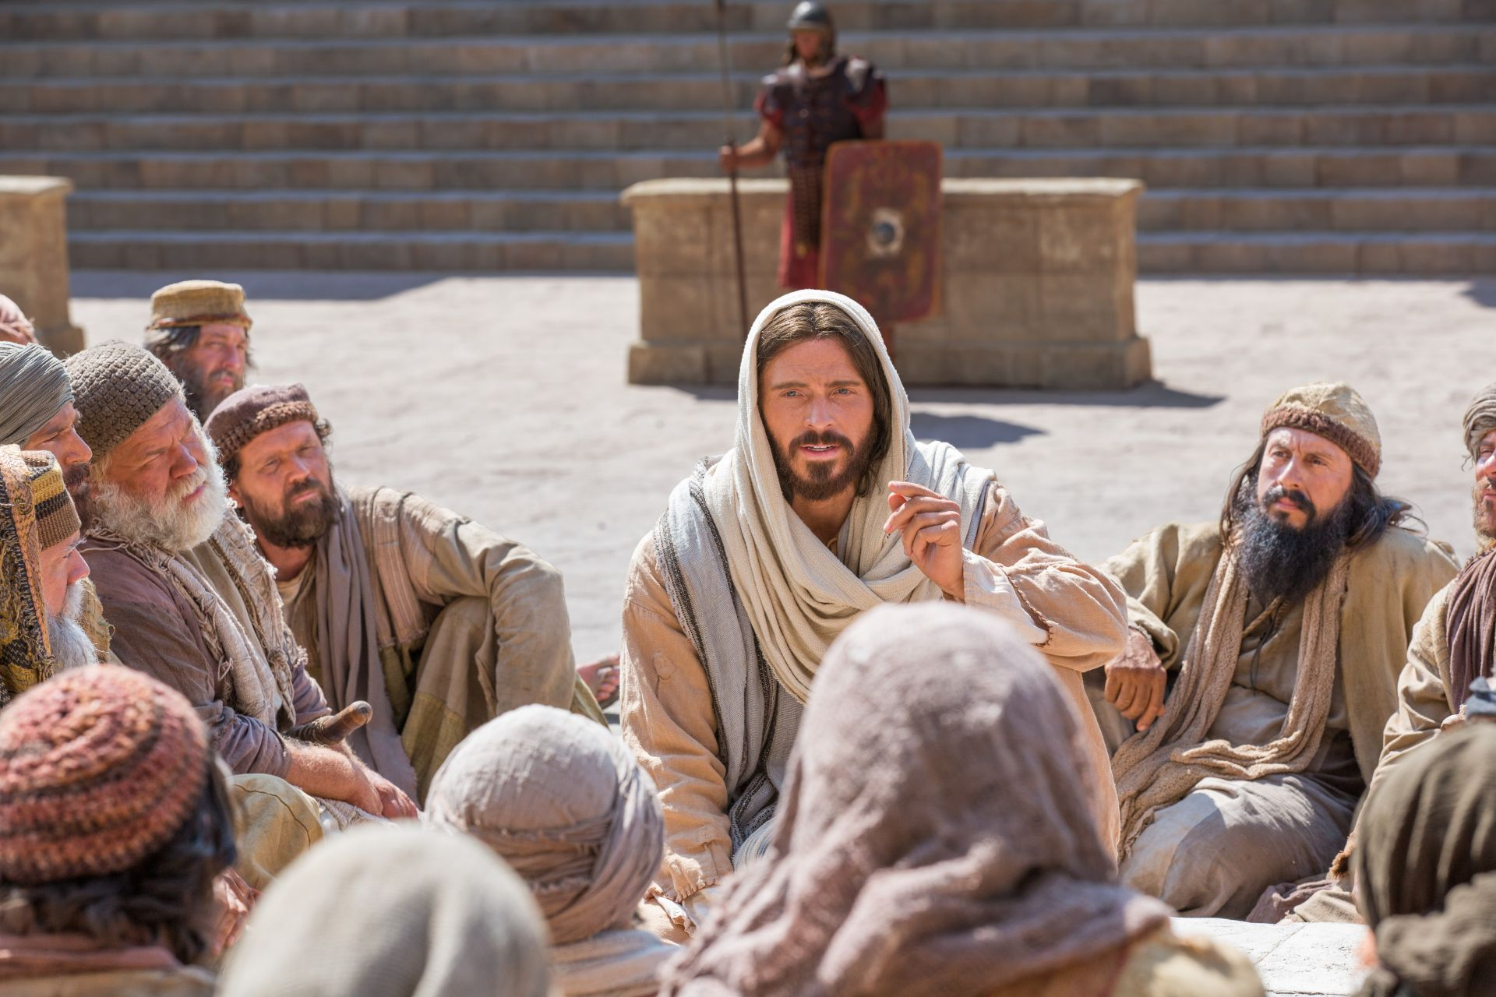
“Il-ħlas tagħhom ġa ħaduh.”

Slide 20
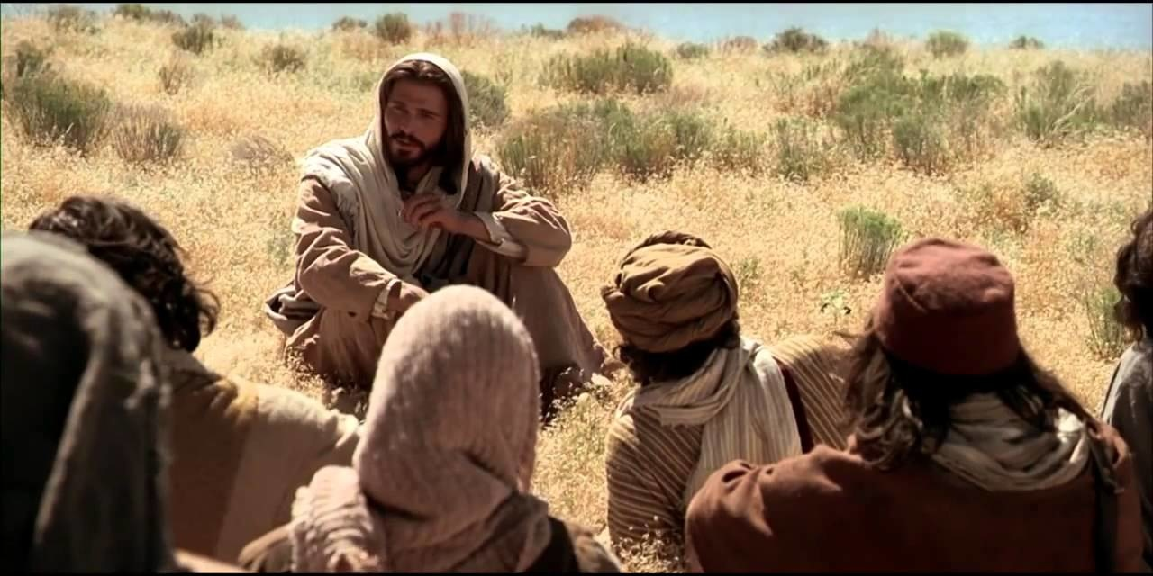
should be consumed between meals
“Idħol fil-kamra
tiegħek ta’ ġewwa.”

Slide 21
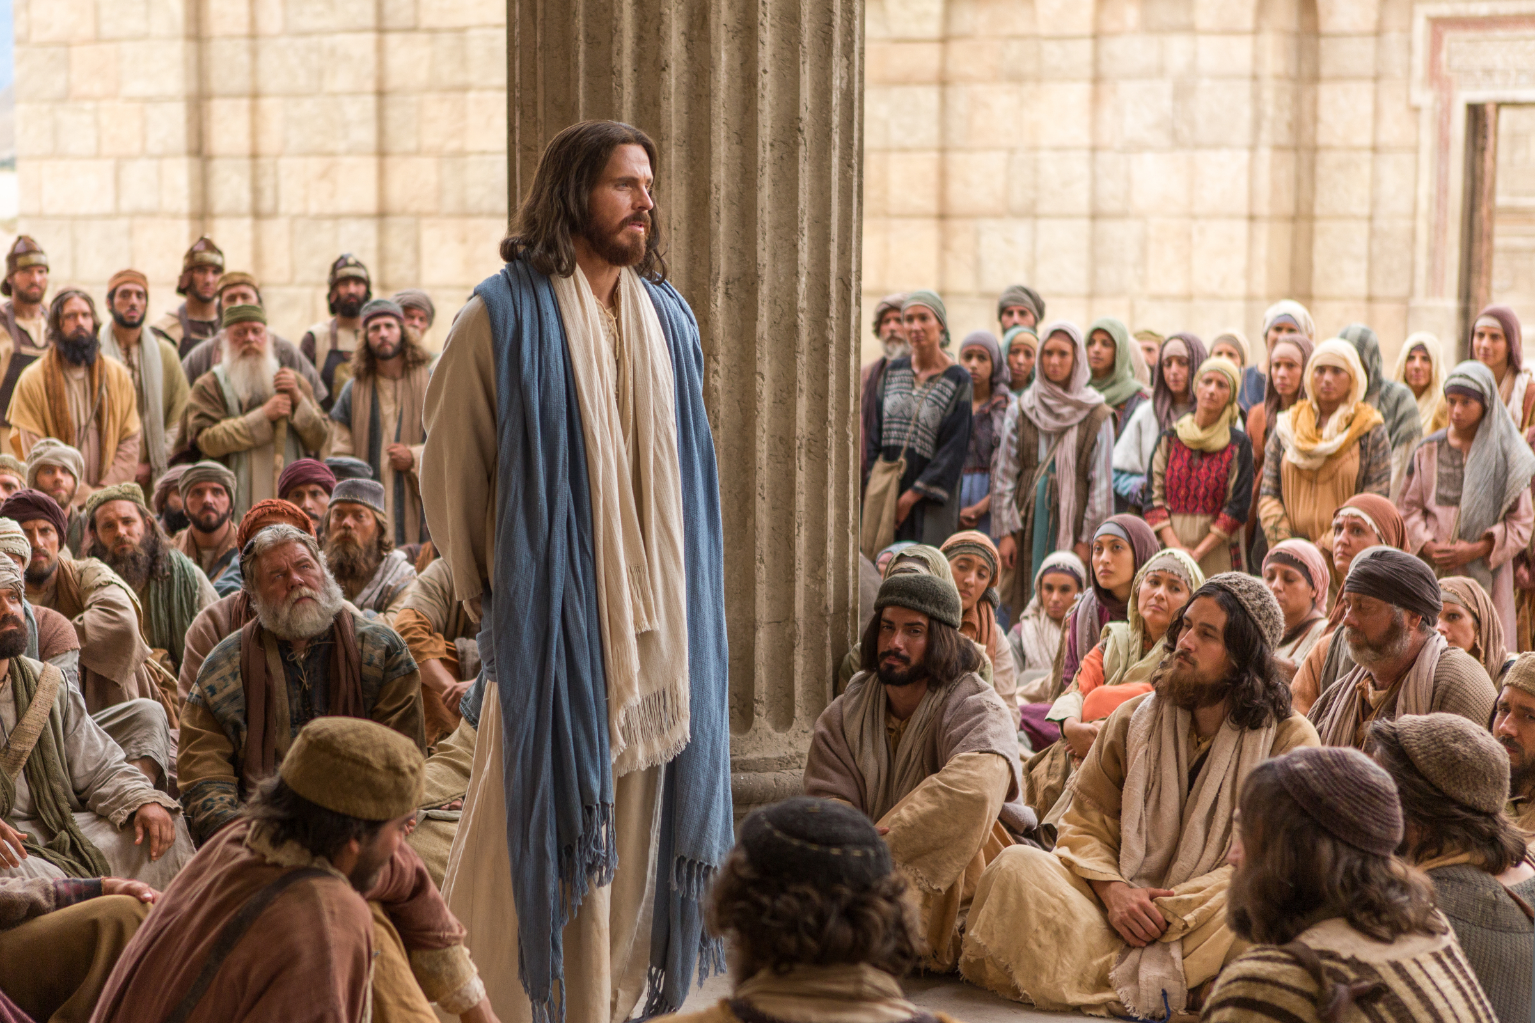
should be consumed between meals
“Missierek, li jara dak li hu fil-moħbi, iroddlok hu.”

Slide 22
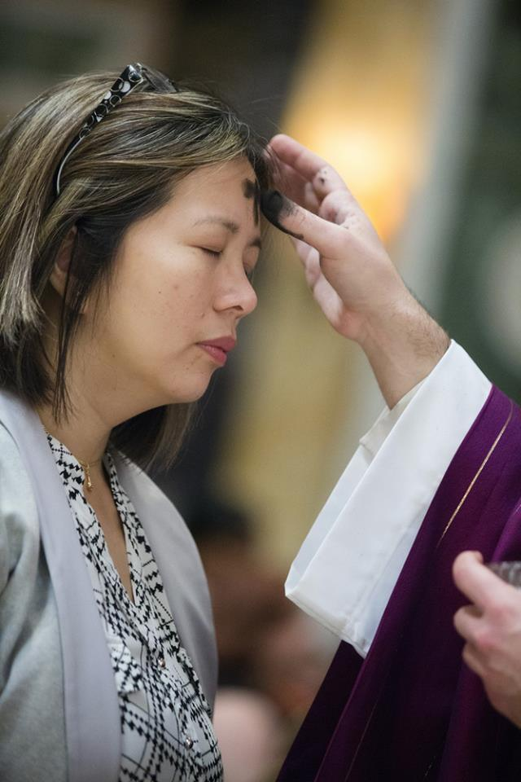
“Indmu u emmnu fl-Evanġelju.”

Slide 23
“Ftakar li inti trab u trab terġa’ ssir.”

Slide 24
